Slide 1
CS F301: Principles of Programing Languages

Slide 2
Object Oriented Programming: Features, Class Hierarchy, Inheritance, Information Hiding, Polymorphism

Slide 3
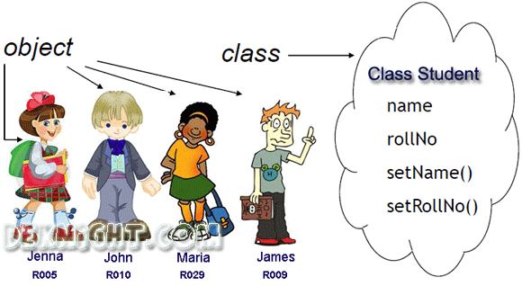
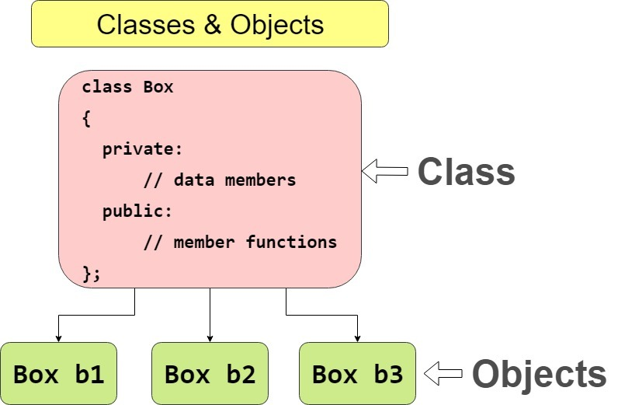
Introduction OOP (1)
Based on concept of objects and classes.
Objects: Represent entities with related state and behaviour 
Instances of a class
Classes: Define common characteristics of similar objects.
Objects are reusable self-contained programming modules with data and functions.
Classes are blue-print for objects with common properties, attributes, operations and behaviours.

Slide 4
Object Oriented Thinking
Object-oriented programming begins with thinking in following way,
Object : Collection of data and operations
Class: Description of a set of objects; objects with common properties[type of an object]
Subclass: Subset of class, with additional properties; nested class
Superclass: Main class that subclasses fall under
Instance: Technical term for an object of class
Method: Procedure body implementing an operation
Message: Procedure call; request to execute method

Slide 5
OOP Features
Object-oriented programming is a programming methodology characterized by the following concepts:
Data Abstraction
DA is a programming technique where one separates the interface from the implementation
Class designer worries about the interface
Programmers implement
Encapsulation
Combine lower level elements to form a new higher level entity.
Grouping of attributes and behaviours to form an object.
Information hiding
Objects contain information
Only part of the information contained in the object might be presented to the user. Rest is concealed.
Internal dynamics are not visible to the user
Polymorphism: The ability to manipulate different kinds of objects, with only one operation.
Inheritance
Inheritance enables you to reuse code and add data and functionality without making any changes to the existing code.
Embodies the "is a" notion: a horse is a mammal, a mammal is a vertebrate, a vertebrate is a lifeform.

Slide 6
O-O Principles and C++ Constructs
O-O Concept C++ Construct(s)
Abstraction Classes
Encapsulation Classes
Information Hiding Public and Private Members
Polymorphism Operator overloading,
virtual functions
Inheritance Derived Classes
(Single and Multiple Inheritance)

Slide 7
Class in C++ (1)
Model objects that have attributes (data members) and behaviours (member functions)
Defined using keyword class
Have a body delineated with braces ({ and })
Class definitions terminate with a semicolon
Example:
1 class Time {
Public: and Private: are member-access specifiers.
2 public:
3 Time();
4 void setTime( int, int, int );
5 void printMilitary();
setTime, printMilitary, and printStandard are member functions. Time is the constructor.
6 void printStandard();
7 private:
8 int hour; // 0 - 23
9 int minute; // 0 - 59
10 int second; // 0 - 59
hour, minute, and second are data members.
11 };

Slide 8
Class in C++ (2)
Member access specifiers
Classes can limit the access to their member functions and data
The three types of access a class can grant are:
Public — Accessible wherever the program has access to an object of the class
private — Accessible only to member functions of the class
Protected — Similar to private, useful during inheritance, class members declared as Protected can be accessed by any subclass(derived class) of that class as well.
Constructor
Special member function that initializes the data members of a class object
Cannot return values
Have the same name as the class

Slide 9
Class in C++ (3)
Destructors
Functions with the same name as the class but preceded with a tilde character (~)
Cannot take arguments and cannot be overloaded
Performs “termination housekeeping”
One destructor per class
Binary scope resolution operator (::)
Scope resolution operator and class name are not needed if function is defined inside the class.
Combines the class name with the member function name
Different classes can have member functions with the same name
Format for defining member functions
ReturnType ClassName::MemberFunctionName( ){
…
}

Slide 10
Object in C++
Class definition and declaration
Once a class has been defined, it can be used as a type in object, array and pointer declarations
Example:
Time sunset, // object of type Time arrayOfTimes[ 5 ], // array of Time objects *pointerToTime, // pointer to a Time object &dinnerTime = sunset; // reference to a Time object
Note: The class name becomes the new type specifier.

Slide 11
Example 1 (1)
#include <iostream>
using namespace std;
class Line {
public:
void setLength( double len );
double getLength( void );
Line(); // This is the constructor declaration
~Line(); // This is the destructor: declaration
private:
double length;
};

Slide 12
Example 1 (2)
// Member functions definitions including constructor
Line::Line(void) {
cout << "Object is being created" << endl;
}
Line::~Line(void) {
cout << "Object is being deleted" << endl;
}
void Line::setLength( double len ) {
length = len;
}
double Line::getLength( void ) {
return length;
}

Slide 13
Example 1 (3)
// Main function for the program
int main() {
Line line;
// set line length
line.setLength(6.0);
cout << "Length of line : " << line.getLength() <<endl;
return 0;
}
Output:
Object is being created
Length of line : 6
Object is being deleted

Slide 14
Inheritance in C++
The language mechanism by which one class acquires the properties (data and operations) of another class
Base Class (or superclass): the class being inherited from
Derived Class (or subclass): the class that inherits
When a class inherits from another class, there are three benefits:
You can reuse the methods and data of the existing class
You can extend the existing class by adding new data and new methods
You can modify the existing class by overloading its methods with your own implementations
Declaration of Inheritance in C++
class derived-class: access-specifier base-class

Slide 15
Example 2
#include <iostream>
using namespace std;
// Base class
class Shape {
public:
void setWidth(int w) {
width = w;
}
void setHeight(int h) {
height = h;
}
protected:
int width;
int height;
};
// Derived class
class Rectangle: public Shape {
public:
int getArea() {
return (width * height);
}
};
int main(void) {
Rectangle Rect;
Rect.setWidth(5);
Rect.setHeight(7);
// Print the area of the object.
cout << "Total area: " << Rect.getArea() << endl;
return 0; }

Slide 16
Access Control and Inheritance
Access Type | public | protected | private
Same class | yes | yes | yes
Derived classes | yes | yes | no
Outside classes | yes | no | no
A derived class can access all the non-private members of its base class. (i.e. public, protected)
Thus base-class members that should not be accessible to the member functions of derived classes, should be declared private in the base class.

Slide 17
Inheritance Types
Inheritance Types: (Inheritance Type is defined by Access Specifiers: public, protected, private)
Public Inheritance is the most common form of inheritance and represents an “is-a” relationship between the base and derived classes.
The following rules are applied, while using different types of inheritance:
Public Inheritance − When deriving from a public base class, public members of the base class become public members in the derived class, and the protected members become protected members.
Protected Inheritance − When deriving from a protected base class, public and protected members of the base class become protected members of the derived class.
Private Inheritance − When deriving from a private base class, public and protected members of the base class become private members of the derived class.
Note: In any case, private members of the base class are inaccessible to the derived class.

Slide 18
Multiple Inheritance
A C++ class can inherit members from more than one class.
Syntax for multiple inheritance
class derived-class: access baseA, access baseB....
Example 3:
#include <iostream>
using namespace std;
// Base class Shape
class Shape {
public:
void setWidth(int w) { width = w; }
void setHeight(int h) { height = h; }
protected:
int width;
int height;
};

Slide 19
Example 3 (contd..)
// Base class PaintCost
class PaintCost {
public:
int getCost(int area) {
return area * 70;
}
};
// Derived class
class Rectangle: public Shape, public PaintCost {
public:
int getArea() {
return (width * height);
}
};
int main(void) {
Rectangle Rect;
int area;
Rect.setWidth(5);
Rect.setHeight(7);
area = Rect.getArea();
// Print the area of the object.
cout << "Total area: " << Rect.getArea() << endl;
// Print the total cost of painting
cout << "Total paint cost: $" << Rect.getCost(area) << endl;
return 0;
}

Slide 20
Polymorphism in C++
The word polymorphism means having many forms.
C++ support polymorphism in following ways
Function overloading
Operator overloading
Virtual function
Function overloading
can have multiple definitions for the same function name in the same scope.
The definition of the function must differ from each other by the types and/or the number of arguments in the argument list.
Example:

Slide 21
Example 4
#include <iostream>
using namespace std;
class printData {
public:
void print(int i) {
cout << "Printing int: " << i << endl;
}
void print(double f) {
cout << "Printing float: " << f << endl;
}
void print(char* c) {
cout << "Printing character: " << c << endl;
}
};
int main(void) {
printData pd;
// Call print to print integer
pd.print(5);
// Call print to print float
pd.print(500.263);
// Call print to print character
pd.print("Hello C++");
return 0;
}

Slide 22
Operator Overloading
Overloaded operators are functions with special names.
Syntax for opetaor overloading,
class className {
... .. ...
public
returnType operator symbol (arguments) {
... .. ...
}
... .. ...
};
Following operators can not be overloaded,
:: .* . ?:

Slide 23
Example 5
#include <iostream>
using namespace std;
class Count {
private:
int value;
public:
// Constructor to initialize count to 5
Count() : value(5) {}
// Overload ++ when used as prefix
void operator ++ () {
++value;
}
void display() {
cout << "Count: " << value << endl;
}
};
int main() {
Count count1;
// Call the "void operator ++ ()" function
++count1;
count1.display();
return 0;
}

Slide 24
Virtual Function
A virtual function is a member function which is declared within a base class and is re-defined(Overriden) by a derived class.
When you refer to a derived class object using a pointer or a reference to the base class, you can call a virtual function for that object and execute the derived class’s version of the function.
They are mainly used to achieve Runtime polymorphism
Functions are declared with a virtual keyword in base class.

Slide 25
Example 6 (1)
#include <iostream>
using namespace std;
class base {
public:
virtual void print()
{
cout << "print base class" << endl;
}
void show()
{
cout << "show base class" << endl;
}
};
class derived : public base {
public:
void print()
{ cout << "print derived class" << endl; }
void show()
{ cout << "show derived class" << endl; }
};
int main()
{
base* bptr;
derived d;
bptr = &d;
// virtual function, binded at runtime
bptr->print();
// Non-virtual function, binded at compile time
bptr->show();
}
Output:
print derived class
show base class

Slide 26
Sources
Ravi Sethi , "Programming Languages: Concepts and Constructs" 2nd Edition by Addison Wesley, 2006 (Reprint 2010).
https://www.tutorialspoint.com/cplusplus
https://www.programiz.com/cpp-programming/operator-overloading
bm.com/support/knowledgecenter/en/SSLTBW_2.2.0/com.ibm.zos.v2r2.cbclx01/cplr139.htm
https://www.geeksforgeeks.org/virtual-function-cpp/
http://www.cs.bu.edu/fac/gkollios

Slide 27
Thank you

